Slide 1
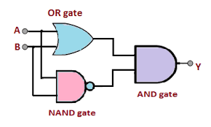
Design XOR Gate
CS550 - Machine Learning and Business Intelligence
Submitted by: Divya Pandey(19665)
Instructor: Dr. Henry Chang

Slide 2
Table of Content
Introduction
Design
Implementation
Test
Enhancement Ideas
Conclusion
References

Slide 3
Introduction
The XOR (Exclusive OR) gate is a logical operation that outputs true only when the inputs differ (one is true and the other is false).
The XOR gate problem was one of the early demonstrations of the power of neural networks and was used to show that neural networks could solve problems that traditional rule-based systems could not

Slide 4
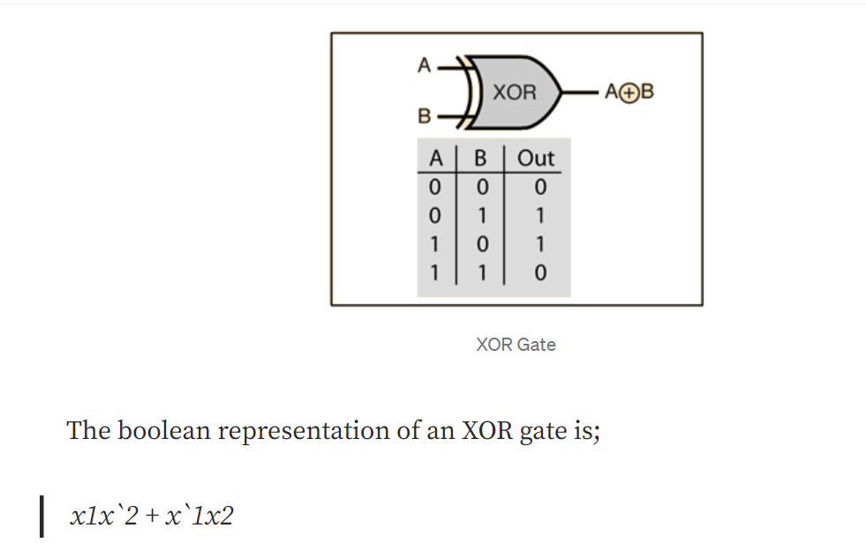
Design

Slide 5
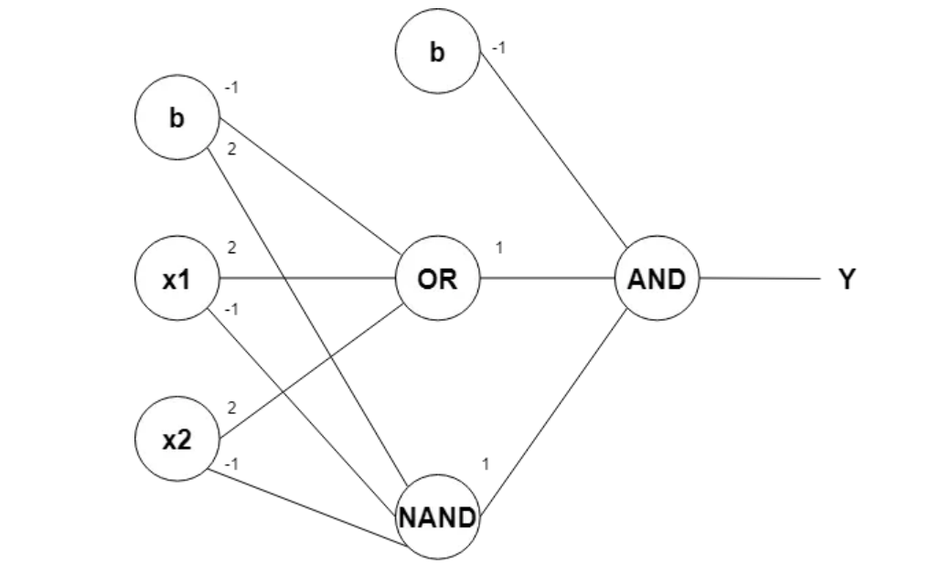
Design

Slide 6
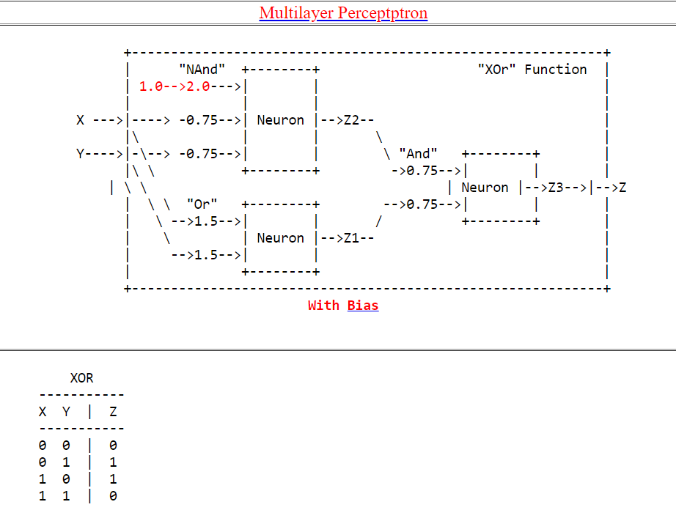
Design

Slide 7
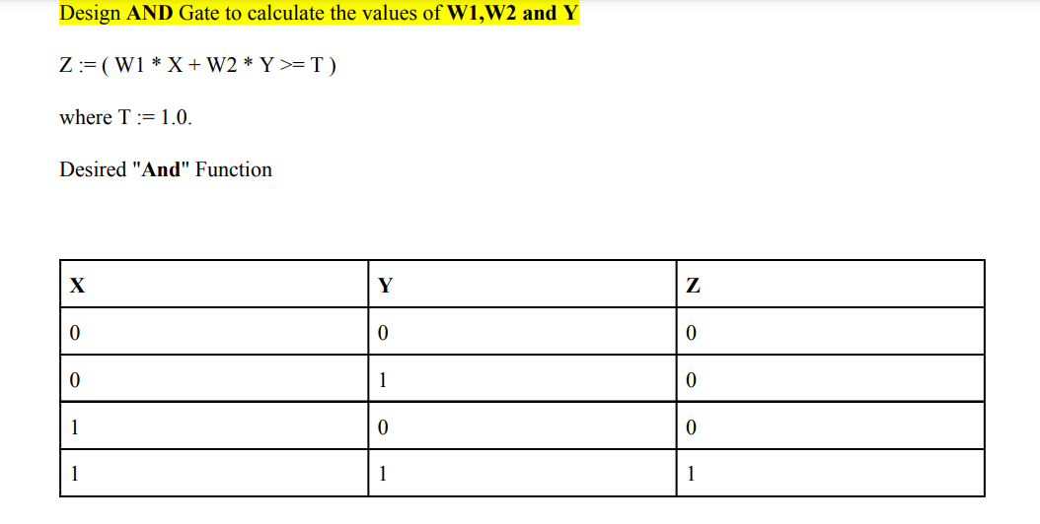
Implementation

Slide 8
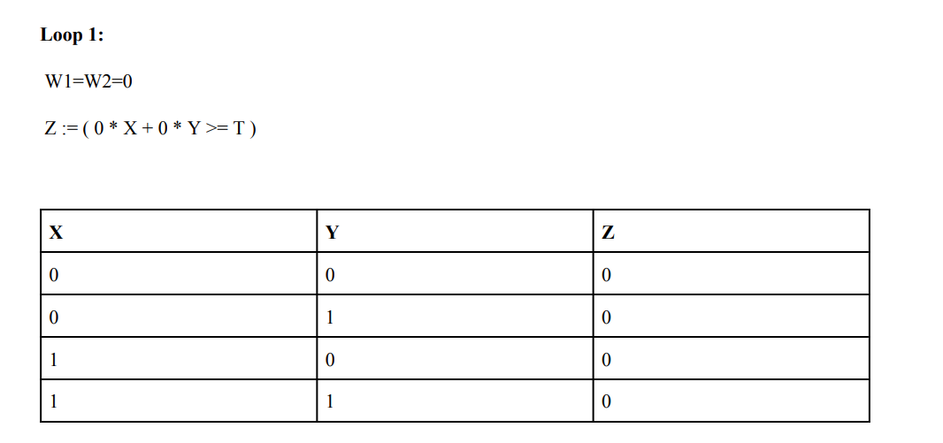
Implementation

Slide 9
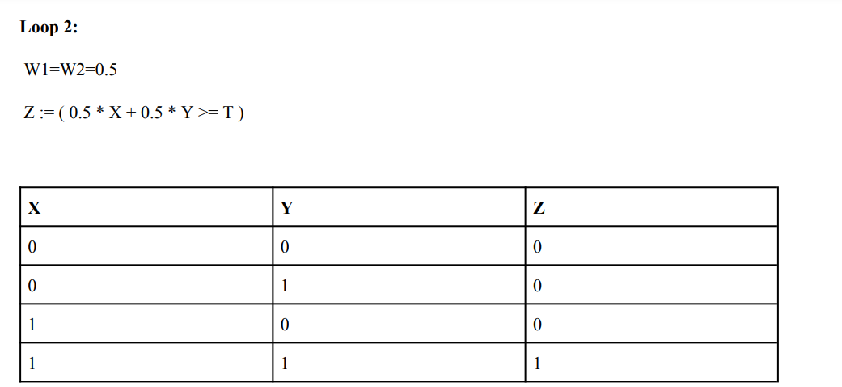
Implementation

Slide 10
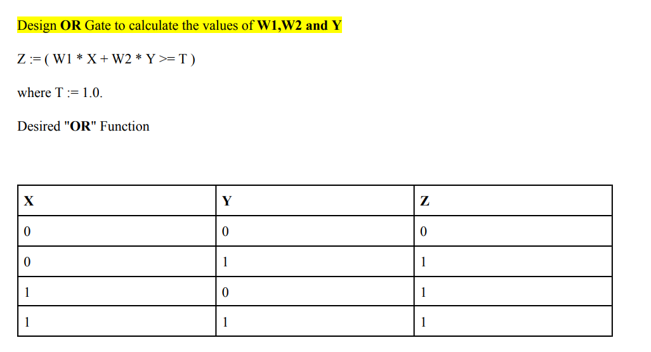
Implementation

Slide 11
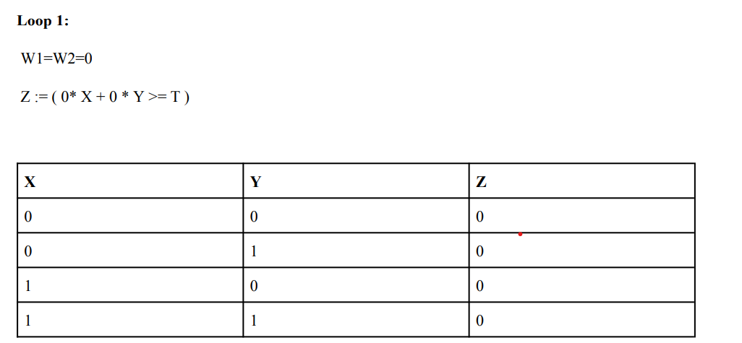
Implementation

Slide 12
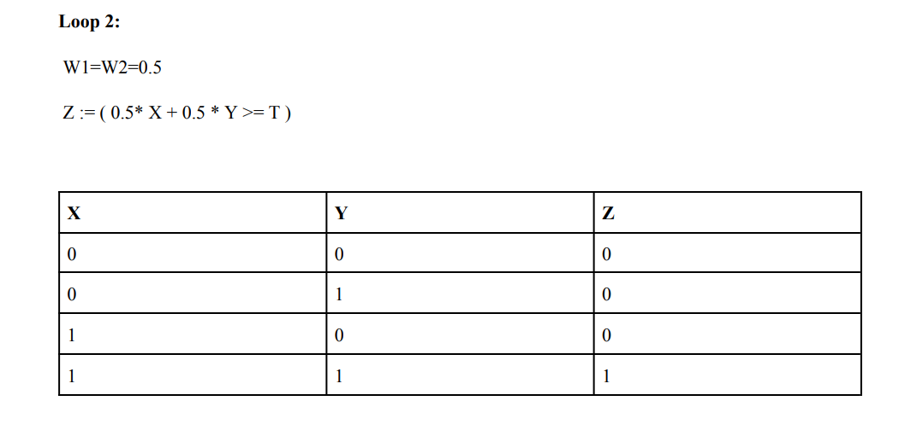
Implementation

Slide 13
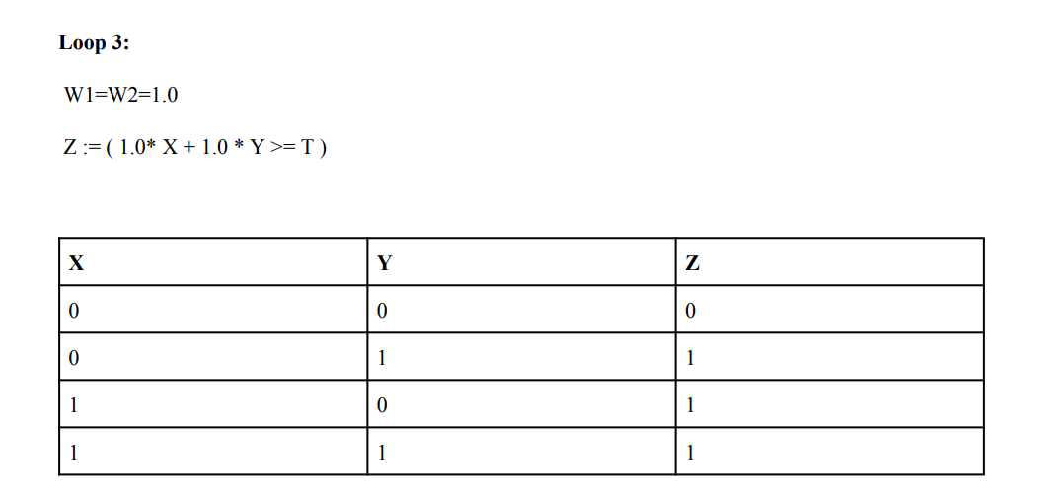
Implementation

Slide 14
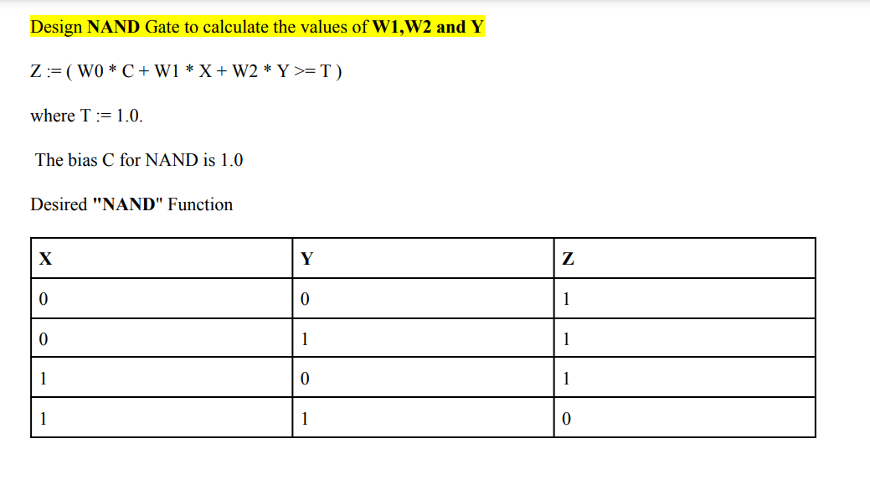
Implementation

Slide 15
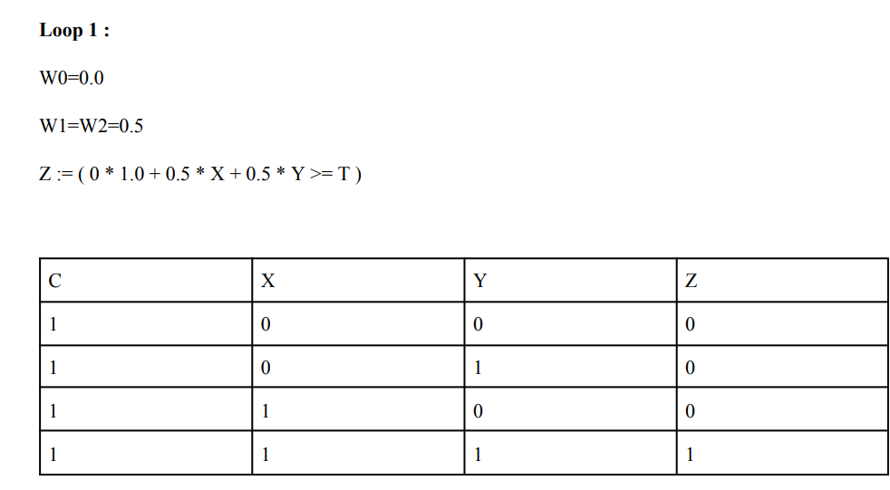
Implementation

Slide 16
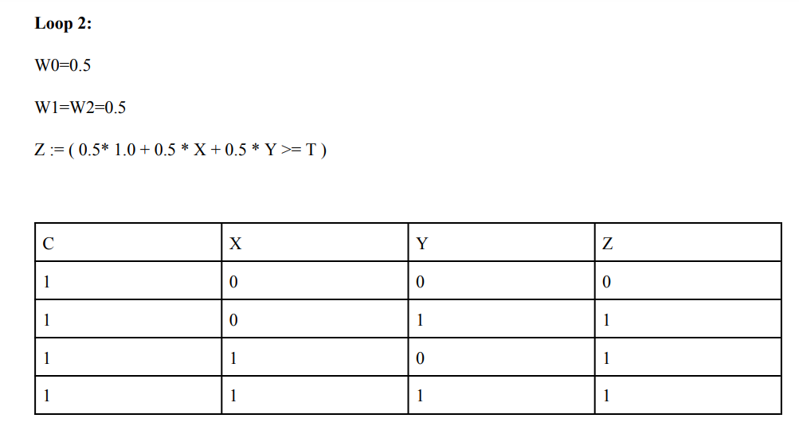
Implementation

Slide 17
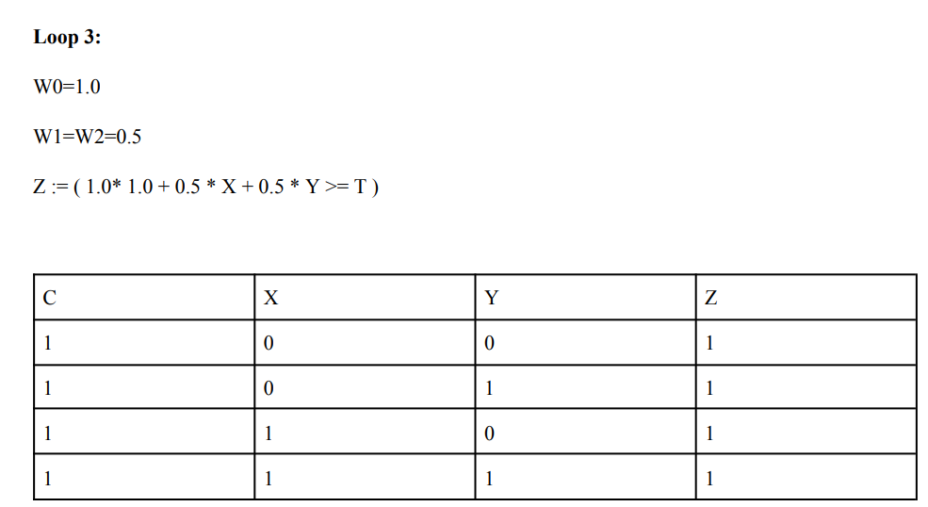
Implementation

Slide 18
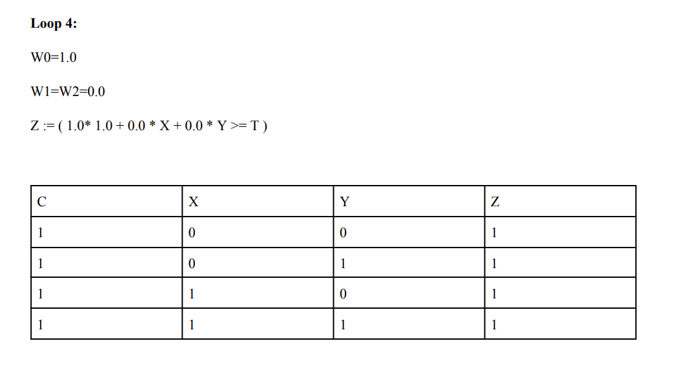
Implementation

Slide 19
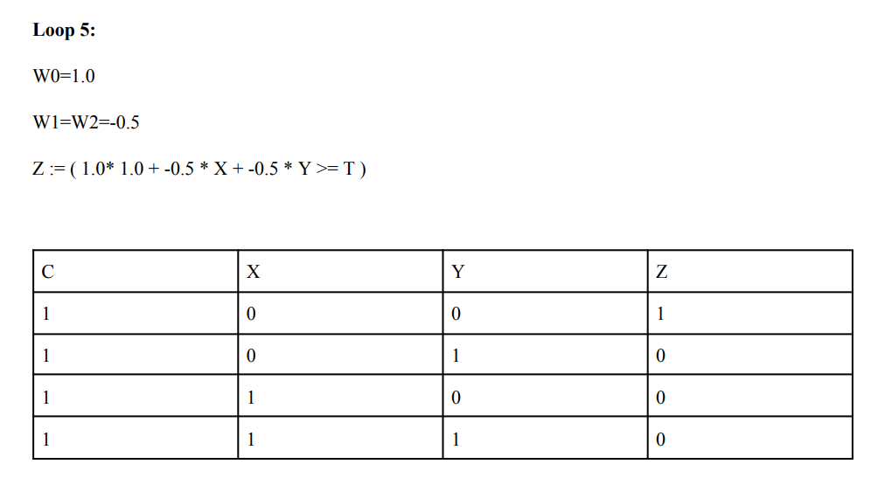
Implementation

Slide 20
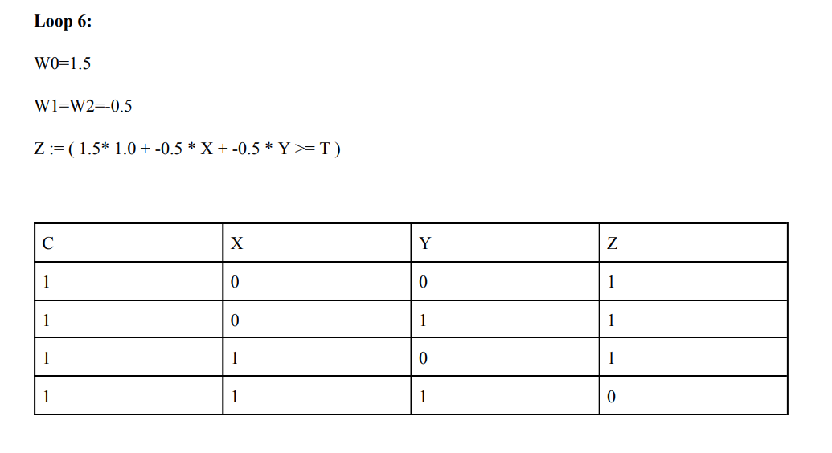
Implementation

Slide 21
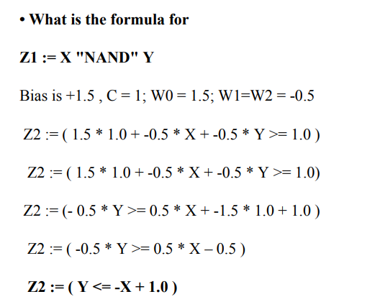
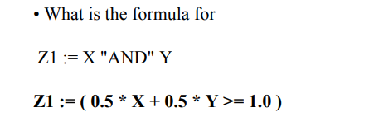
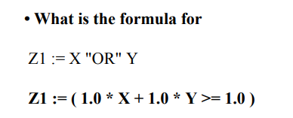
Test

Slide 22
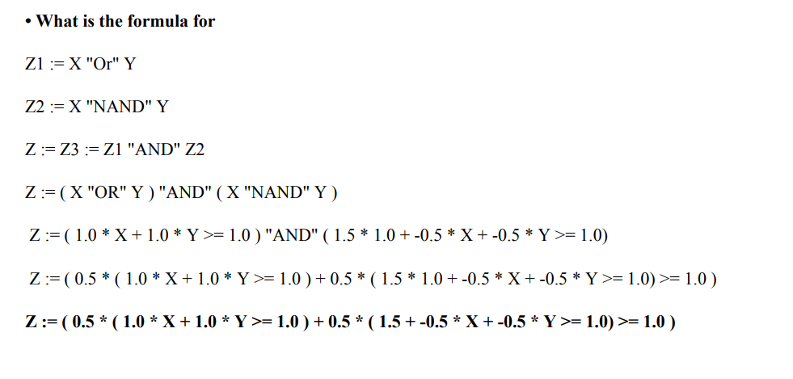
Test

Slide 23
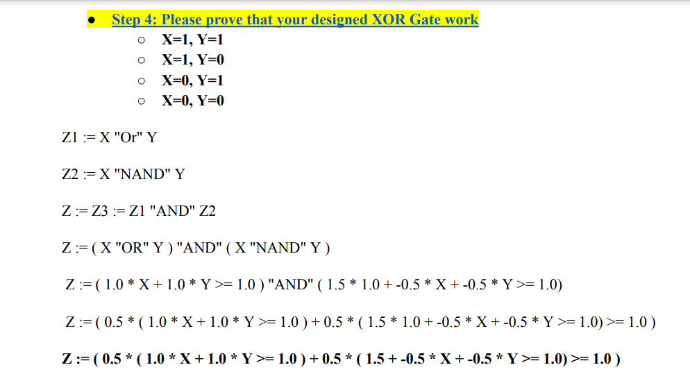
Test

Slide 24
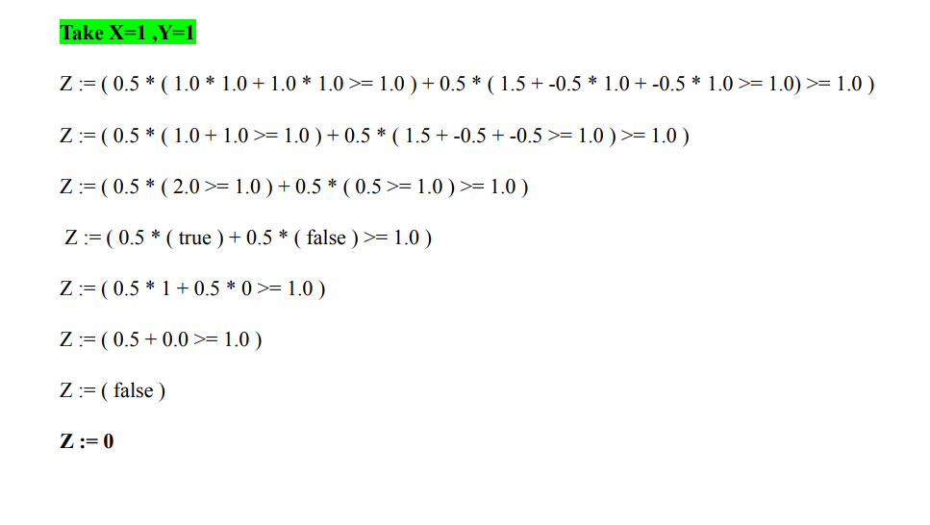
Test

Slide 25
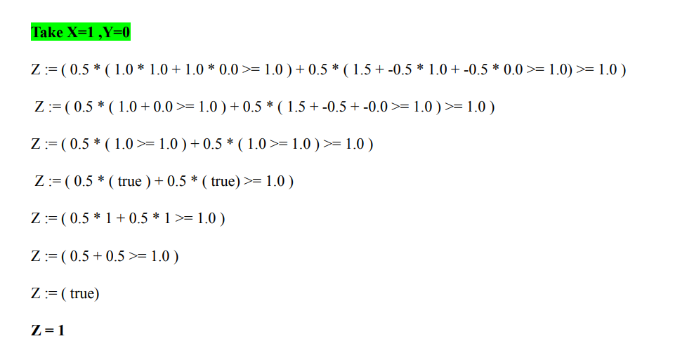
Test

Slide 26
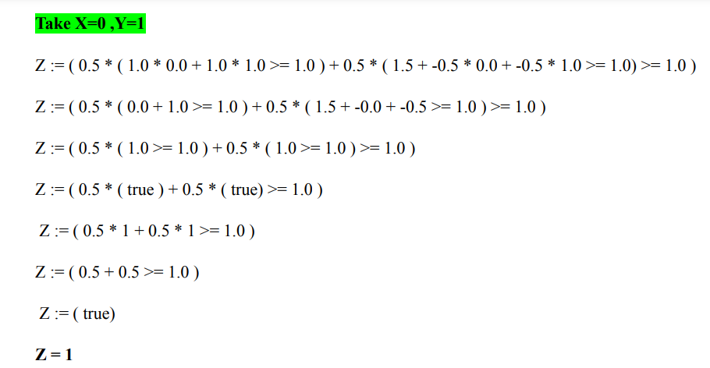
Test

Slide 27
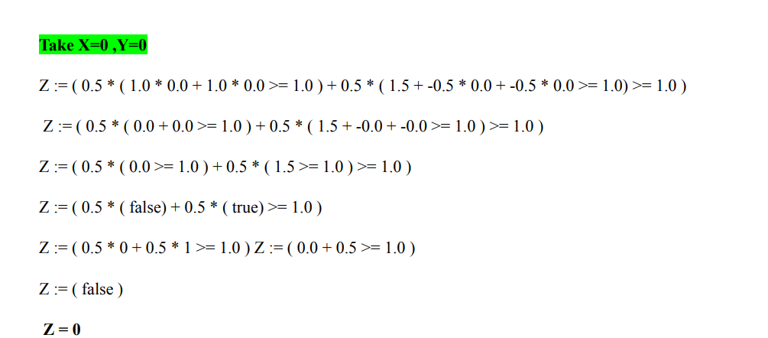
Test

Slide 28
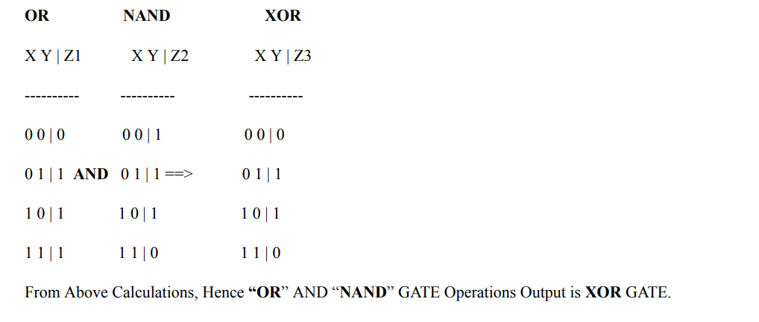
Test

Slide 29
Enhancement Ideas
We can use try implementing XOR gate using different neural network architectures such as Convolutional Neural Networks (CNNs) or Recurrent Neural Networks (RNNs) to see if they improve the performance of the XOR gate.

Slide 30
Conclusion
Overall, the XOR problem is an important problem in neural networks because it has been used extensively to demonstrate the power and limitations of different neural network architectures and techniques, and is still relevant today as a benchmark problem for evaluating the performance of new neural network models.

Slide 31
GitHub Link
https://github.com/divyapandey03/Machine-Learning/tree/main/Supervised%20Learning/Classification%20on%20Colab%20using%20MNIST%20dataset

Slide 32
References
Dukor, S. (2020, March 07). Neural representation of and, or, not, XOR and XNOR logic gates (Perceptron algorithm). Retrieved March 30, 2023, from https://medium.com/@stanleydukor/neural-representation-of-and-or-not-xor-and-xnor-logic-gates-perceptron-algorithm-b0275375fea1
https://hc.labnet.sfbu.edu/~henry/sfbu/course/machine_learning/neural_network/slide/ann.html#gate

